Slide 1
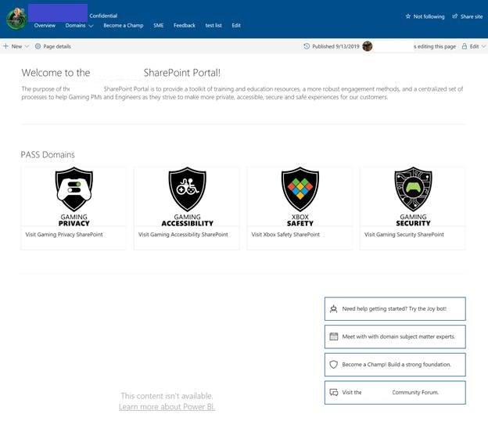

Xbox – CEP Gaming “Lionfish”
Overview
Xbox Game Studios came to Affirma to develop an interactive SharePoint Portal that allowed every employee to learn about the requirements that comprise the studios key “pillars” and ensure games in development followed the organizations best practices.
Affirma
Developed SharePoint sites for the four key pillars, all of which hosted dynamic information such as external tools, detailed requirements, and collaborative documents.
Content on these pillar sites integrated with an existing Azure DevOps Environment.
Configured a highly-customized search and permissions structure, ensuring sensitive data remained secure while allowing users to easily find the content they needed.

